Slide 1


Vapor Compression – Chiller system performance Analysis
Renewable Energy Heat
Silvia Caballero, Ritu Ritu
01.02.2024

Slide 2
Content
Motivation & objective
Demand
System configuration
Results & Conclusion
Discussion

Slide 3
Motivation
Temperatures have risen across various Colombian cities due to increasing climate changes leading to increased use of cooling system
Need for energy efficient air conditioner and refrigeration systems
Objective
Modelling of DX16TC vapor compression chiller
Performance analysis

Slide 4
Location
Location:
Barranquilla – Colombia
Amb Temp= 32°C
Monthly average temperature for Barranquilla Colombia
Data Source: https://www.climatestotravel.com/climate/colombia
Seite 4
01.02.2024

Slide 5

Definition of the system and demand
Vapor Compression Chiller system for space cooling
Office area = 60 m²
Capacity Needed = 3 TR = 36.000 Btu/h
Temp demand = 23 °C
Seite 4
01.02.2024

Slide 6
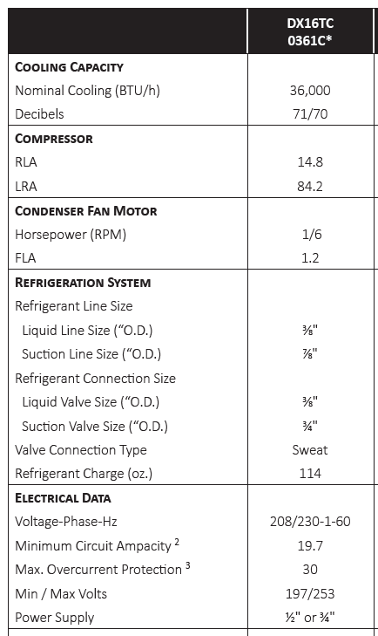
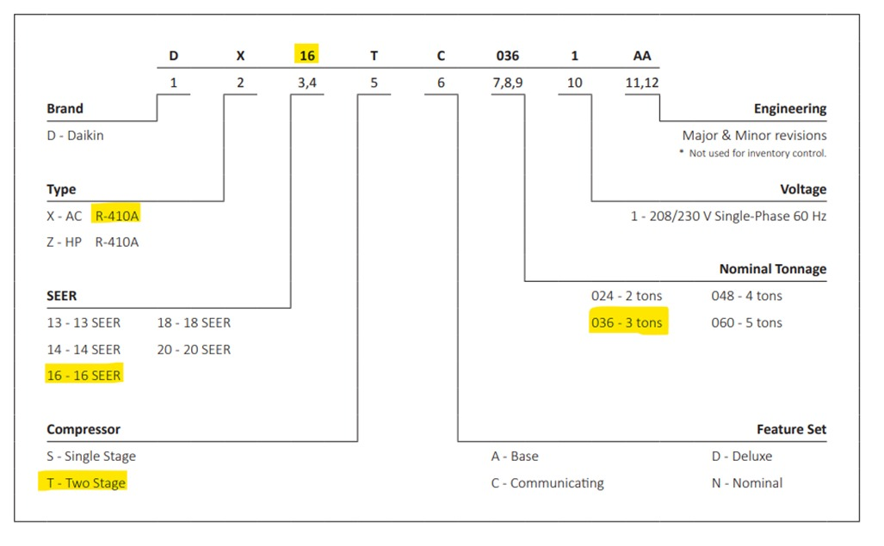
System configuration
REFEENCE: DATA SHEET High Efficiency, Communicating, Split System Air Conditioner DAIKIN DX16TC
Manual/datasheet:

Slide 7
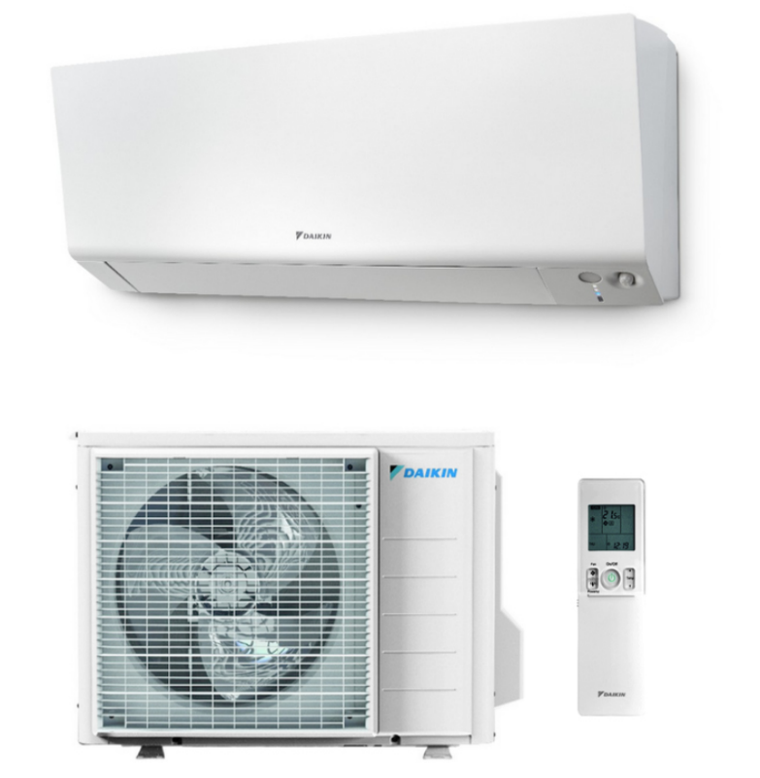
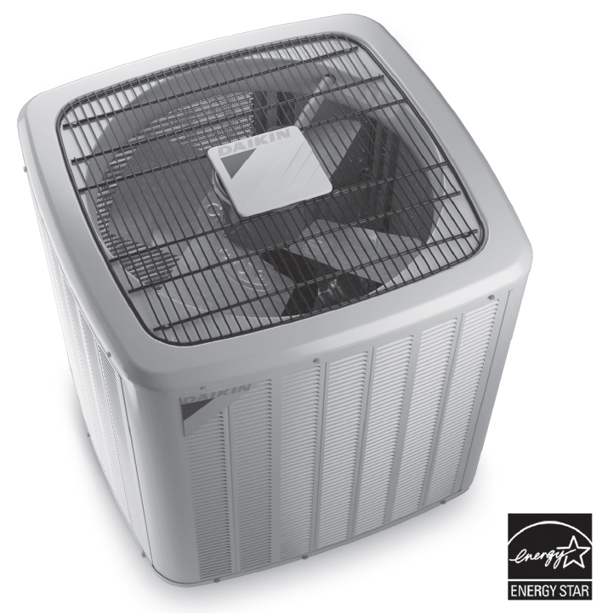
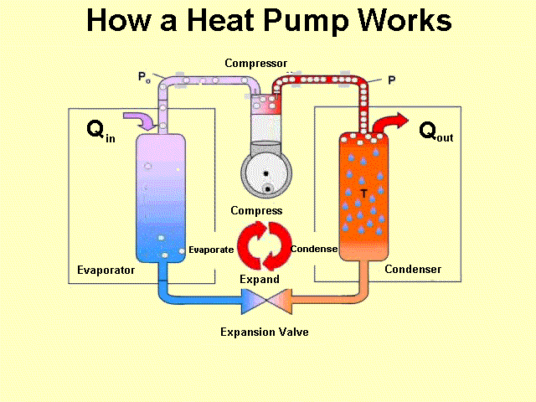
System configuration
Vapor compression chiller - DAIKIN
Parameters:
Fluid : R410a
Compressor efficiency = 0.8
source: https://advensol.ie/services/heat-pumps.html
REFERENCE: DATA SHEET High Efficiency, Communicating, Split System Air Conditioner DAIKIN DX16TC

Slide 8
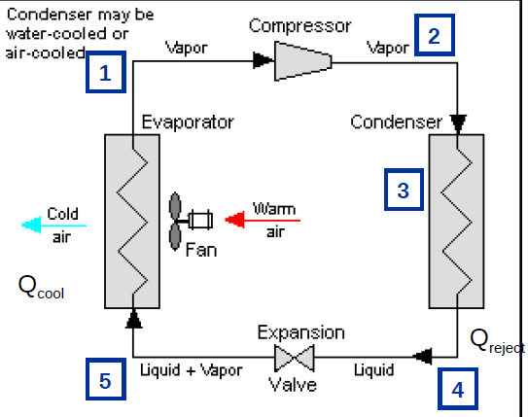
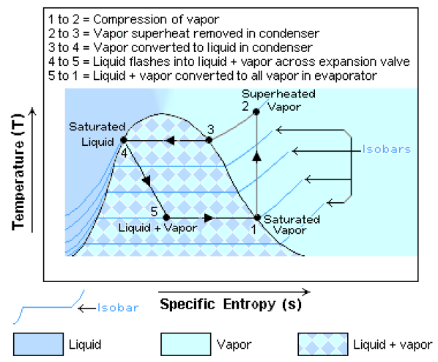
System configuration
Evaporation Temp = 3°C
Condensation Temp = 42°C

Slide 9
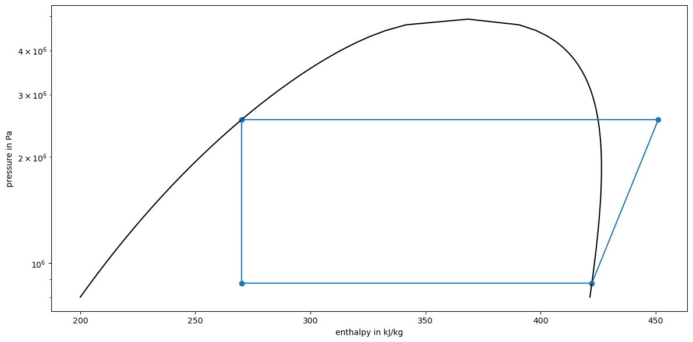
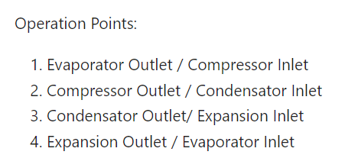
Results & Conclusion
3
2
4
1

Slide 10
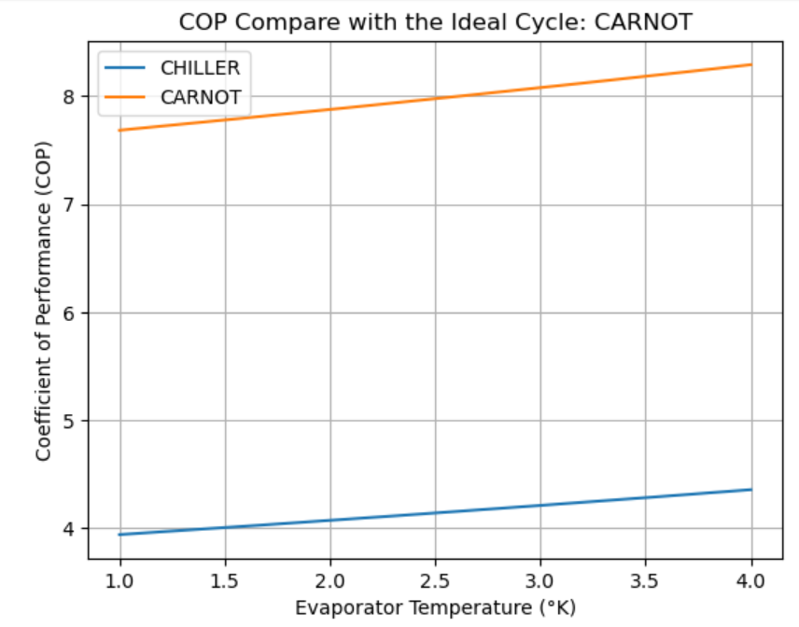
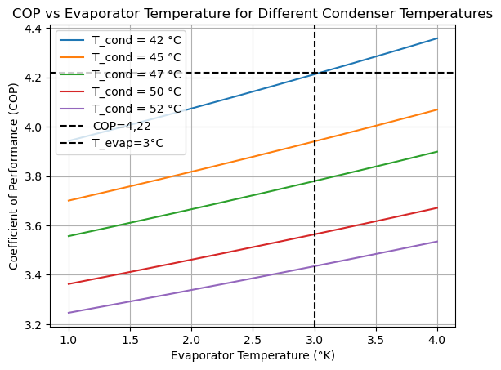
Results & Conclusion
COP = 4,22

Slide 11
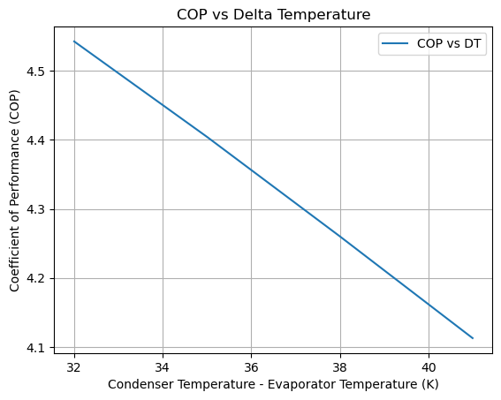
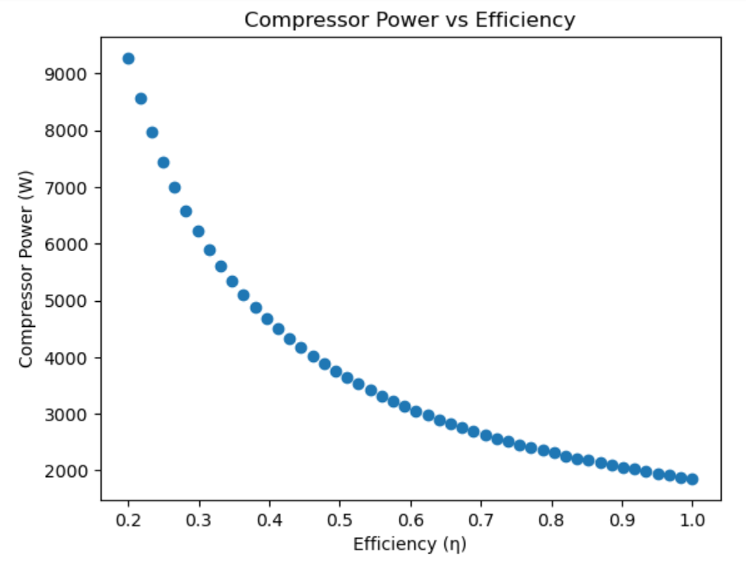
Results & Conclusion

Slide 12
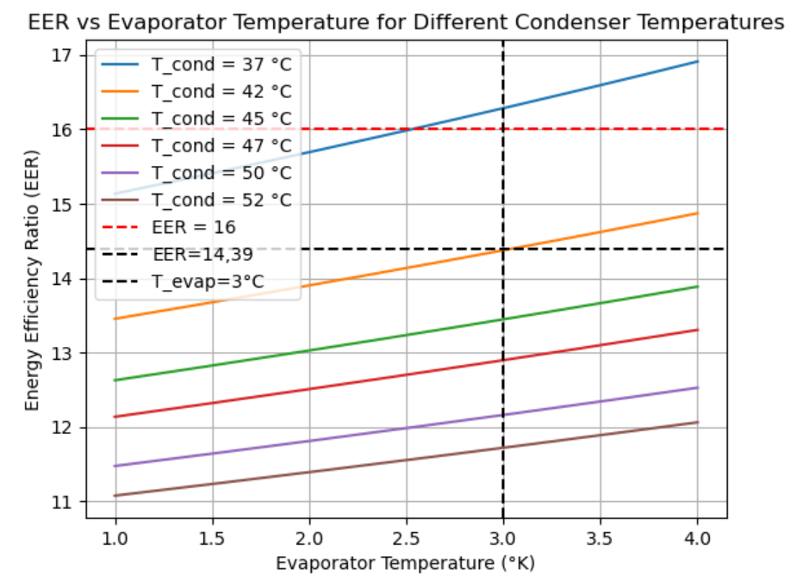
Results & Conclusion
EER – Datasheet = 16
EER – System = 14,39

Slide 13
Discussion
As the evaporator temperature increases, the COP increases. We are interested in having the highest evaporator temperature possible in order to have better performance (COP).
As condensation temperature increases, the COP decreases. We are interested in having the lowest condenser temperature possible in order to have better performance (COP).
In conclusion, having the smaller delta temperature between the evaporator temperature and the condenser temperature (DT=Tcond-Tevap); The performance of the system (COP) is higher.
Cooling systems are related to EER instead of the COP; which refers to the capacity of the system in tons of refrigeration.

Slide 14
Thank you.
Questions?

